Slide 1

Market Place Retail profitability analysis
Aurélie GABU

Slide 2

Agenda
1. Introduction and Background
2. Methodology
3. Data Analysis.
4. Policy recommendations.
5. Conclusion and Questions

Slide 3




Introduction
Main objective
Explore and target a profitable market to increase profits and reduce costs.
Problematic
How do you identify and target the most profitable markets?
How can costs be reduced?
Context
Dataset description: 8047 lines, 17 columns

Slide 4

Methodology
Data collection and exploration. (pandas)
Create a Power BI dashboard.
Identification of the most profitable markets and products.
Insights-based recommendations.

Slide 5


Dashboard (Data Analytics)
Dashboard link

Slide 6
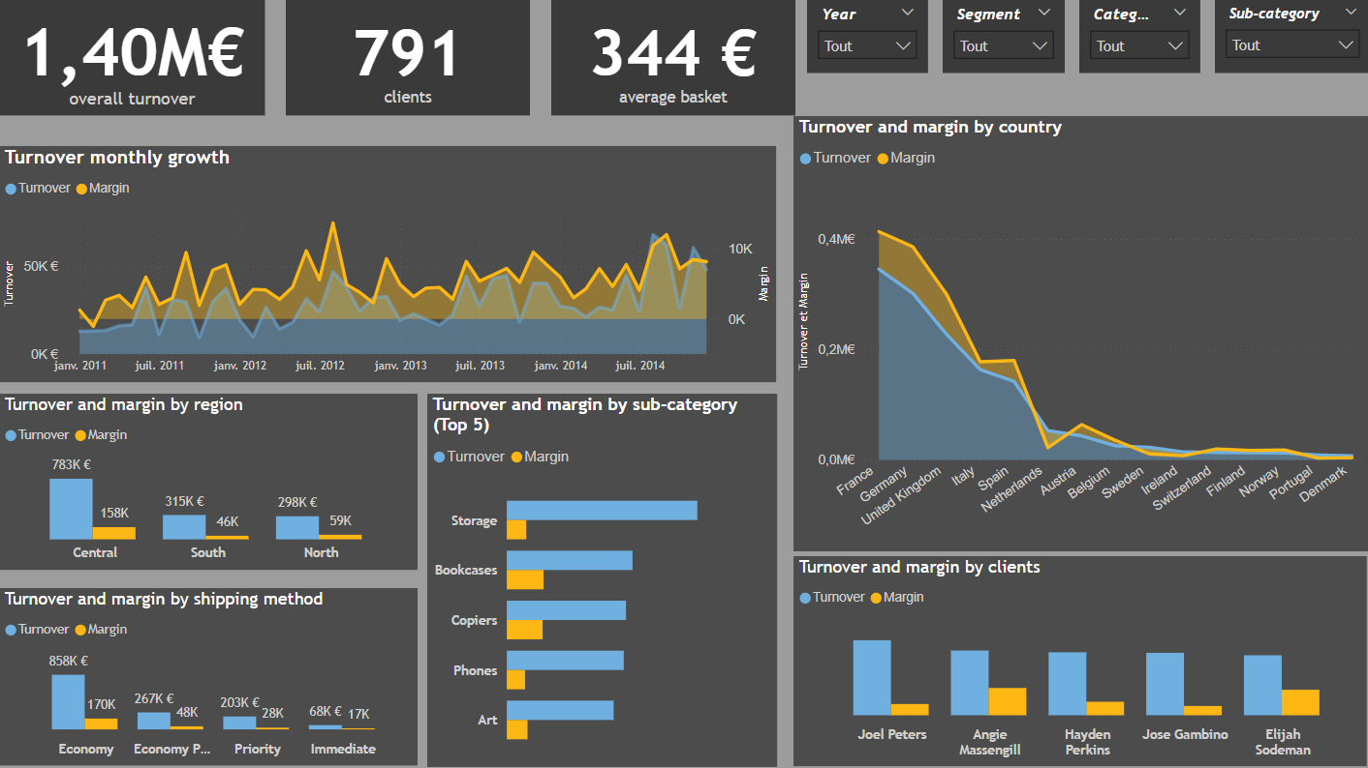
Turnover
Solid overall revenue performance, mainly concentrated in 3 countries: France, UK, Germany. In addition, Germany and the UK have the most impact on profitability.
Top 5 products generating the largest share of turnover, not being the most profitable in the end
The "Economy" delivery method accounts for the most turnover to this extent.

Slide 7
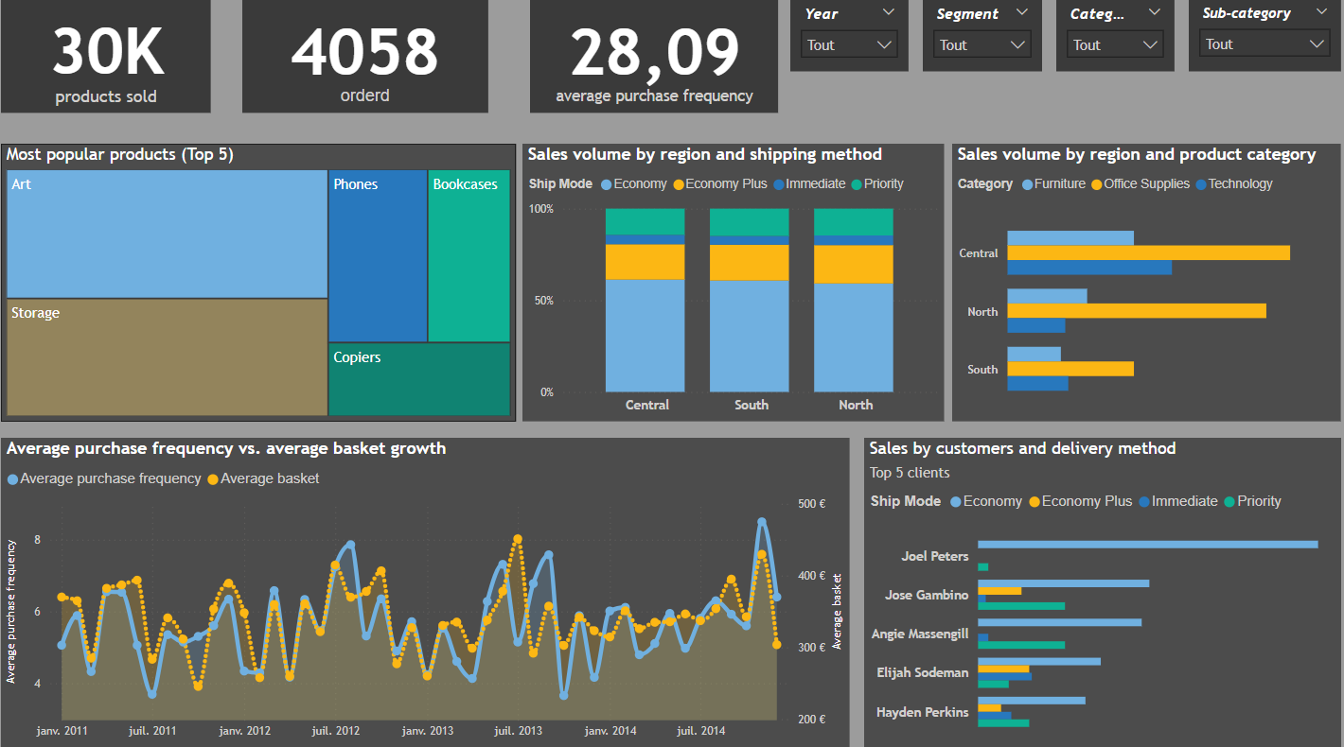
Sales: number of orders
Analysis of the commercial performance highlighting:
Sales volume: the total number of products sold and orders placed give an indication of the level of activity of the company; as well as the 5 most popular products
Customer behavior: the average purchase frequency in relation to the average basket gives an indication of customers' purchasing habits.
The efficiency of shipping methods and their impact on sales

Slide 8
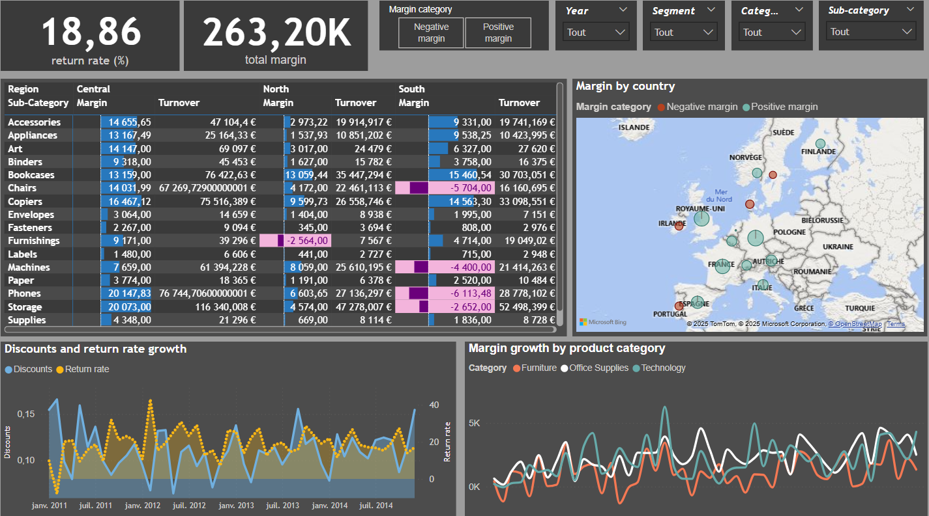
Profitability
Low overall profitability rate: 18.86% indicates a relatively low profit margin.
Negative margins per product: Several products generate negative margins, which directly impacts overall profitability
Regional disparities: Margins vary significantly from a region to another, suggesting different market dynamics
Margin change over time: The margin rate evolution chart shows significant fluctuations, indicating trends to be analyzed

Slide 9

Recommendations
Customer segmentation: according to their consumption habits, it would be interesting to segment customers according to their purchase frequency, total purchase amount and life cycle in the company or recency in order to better identify the most profitable customers
Focus efforts on the most profitable markets: Allocate more marketing and sales resources to the most promising regions and products.

Slide 10
Recommendations
Optimize prices: Adjust prices based on demand and competition to maximize margin.
New Product Development: Identify new products with high potential and develop new markets.
Regular monitoring of sales performance through the implementation of automated key indicators

Slide 11




Thank you
Market Place Retail profitability analysis
2025-01

